Slide 1
Microeconomics for Business
Chapter 7 – Price Discrimination
First-Degree Price Discrimination

Slide 2
Perfect Competition Assumptions | How firms try to beat it | Economic Term
All goods the same | Differentiate your product | Monopolistic Competition
 | Patent/Copyright | Monopoly
Many buyers and sellers | Horizontal/Vertical integration Price Wars | Monopoly Game Theory
Easy Entry/Exit | Erect barriers to entry (regulatory capture) | Monopoly
Everyone knows price and good quality | Come up with ways to offer different prices to different consumers | Price Discrimination

Slide 3
https://www.youtube.com/watch?v=FcWgvRXbet8

Slide 4
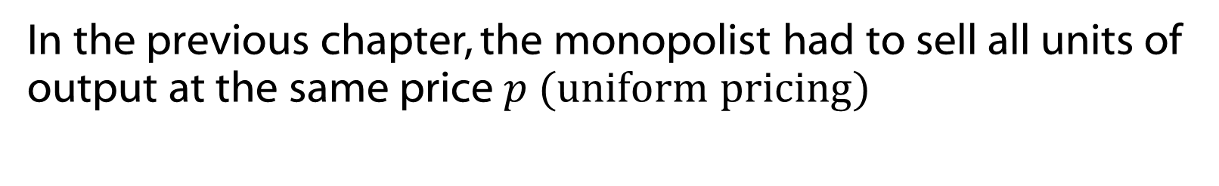
Overview
In this chapter, the monopolist can engage in price discrimination (or differential pricing). That is, the monopolist can sell its output at different prices.

Slide 5
Overview
We will study a few examples of differential pricing strategies.
They are tools used to transfer consumer surplus from the consumer to the firm.
Differential pricing is not illegal except when it would violate civil law or where it is employed to limit competition.

Slide 6
Overview
Two necessary conditions:
Limited opportunities for arbitrage
Costs of differential pricing are not greater than its incremental benefits

Slide 7
First-Degree Price Discrimination
First-Degree Price Discrimination (also called perfect price discrimination) involves each unit of a product being sold at that unit's maximum or reservation price.

Slide 8
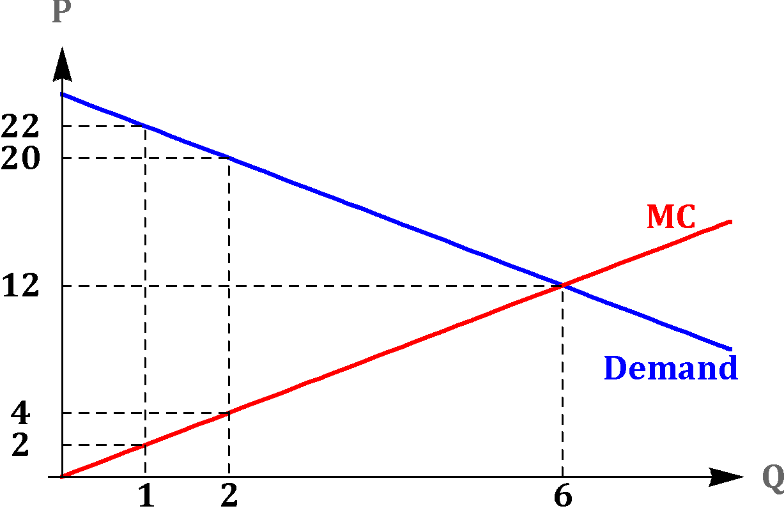


First-Degree Price Discrimination: Profit Maximization
Example:
Inverse Demand
Marginal Cost

Slide 9


First-Degree Price Discrimination: Profit Maximization
Example:
Inverse Demand
Marginal Cost
To max profit set Q where MC(Q) = p

Slide 10
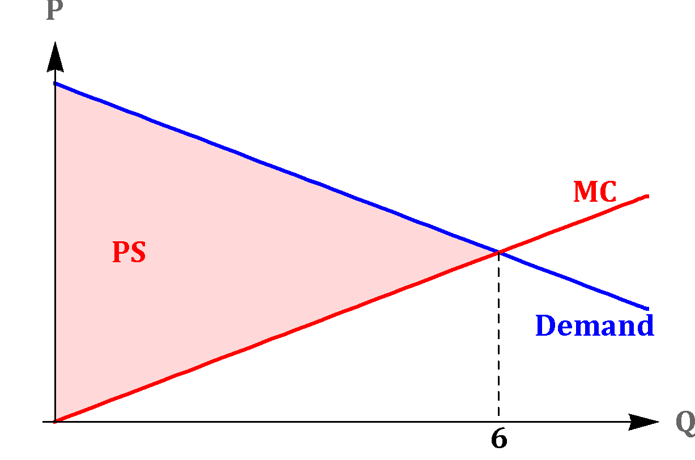

First-Degree Price Discrimination
Example:
Inverse Demand
Marginal Cost
Because the max price is charged for each unit, profit is producer surplus at the Q where p = MC.

Slide 11
First-Degree Price Discrimination
Example:
The perfect discriminator maximizes total surplus as does a competitive market. However, the firm takes all surplus. Consumer surplus is zero.

Slide 12
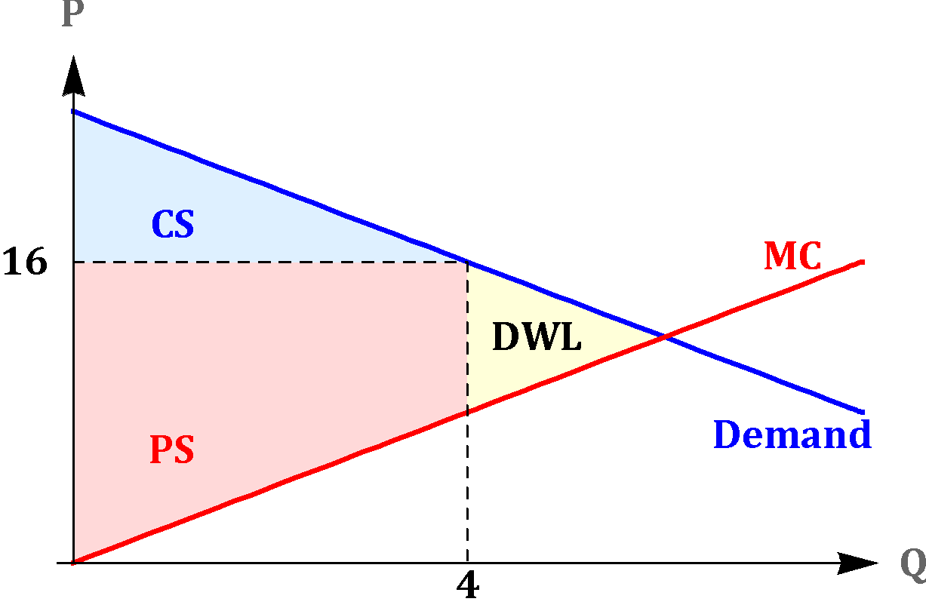
First-Degree Price Discrimination
Monopolist without Price discrimination
First-Degree Price Discrimination

Slide 13
First-Degree Price Discrimination
Monopolist without Price discrimination
First-Degree Price Discrimination

Slide 14
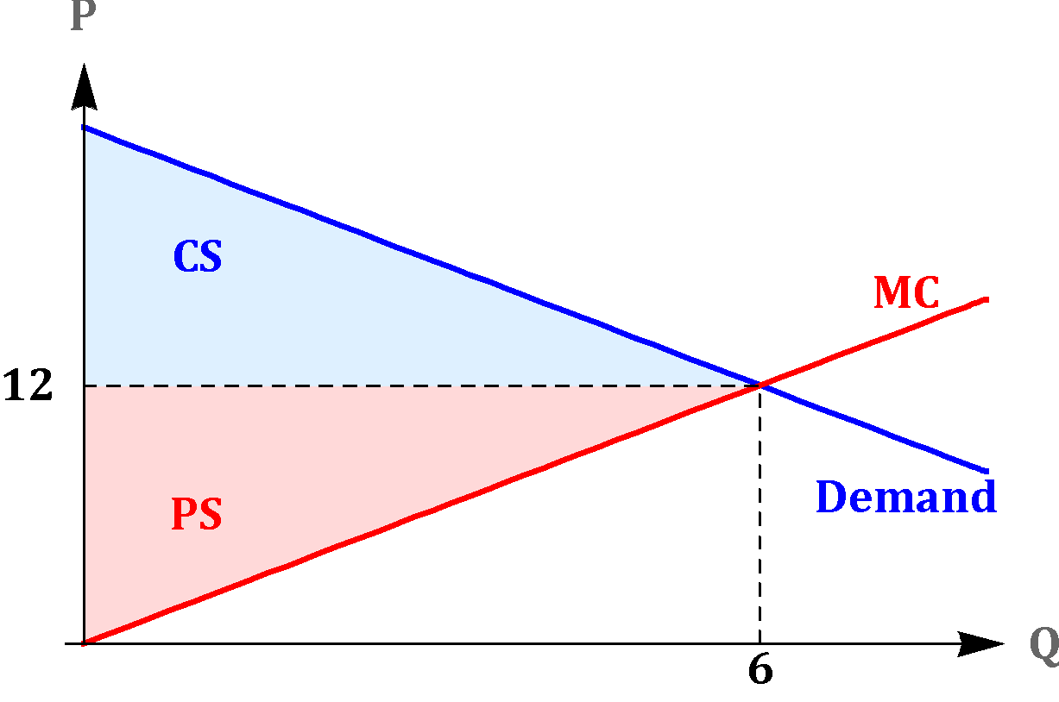
First-Degree Price Discrimination
Perfect Competition
First-Degree Price Discrimination

Slide 15
First-Degree Price Discrimination
Perfect Competition
First-Degree Price Discrimination

Slide 16
First-Degree Price Discrimination
To fully implement first-degree price discrimination, the firm needs a lot of information.
In practice, some firms can implement strategies of imperfect first degree price discrimination.
Example: car salesperson haggling with a customer

Slide 17
First-Degree Price Discrimination
Approximate first-degree discrimination becomes more likely as companies collect an increasing amount of information from individuals online. This is made possible with advances in big data analysis.
Can you think of a good with price discrimination?

Slide 18
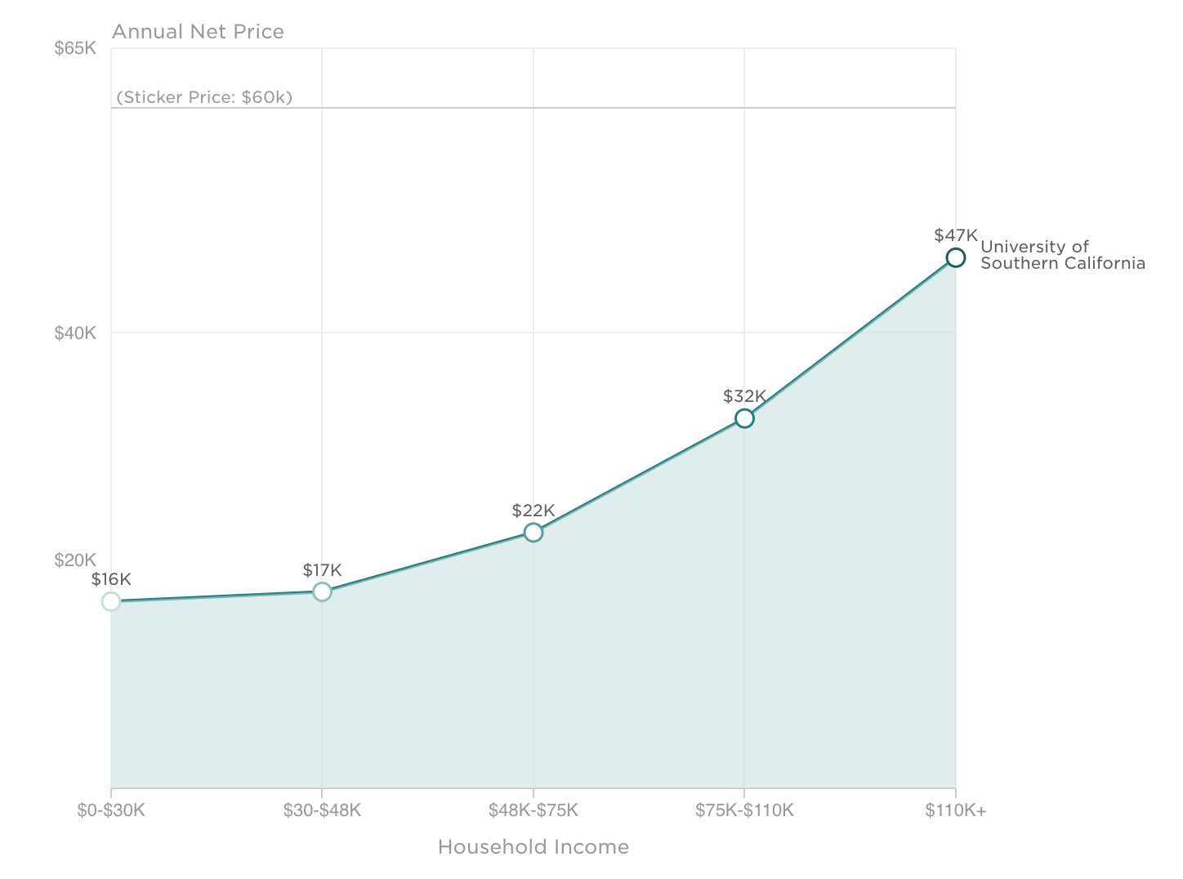
Price Discrimination on Tuition (https://collegescorecard.ed.gov/school/?123961-University-of-Southern-California)

Slide 19
Microeconomics for Business
Chapter 7 – Price Discrimination
Second-Degree Price Discrimination

Slide 20
Second-Degree Price Discrimination
Second-degree price discrimination: each consumer effectively pays different prices for different quantities of output.
Example?

Slide 21
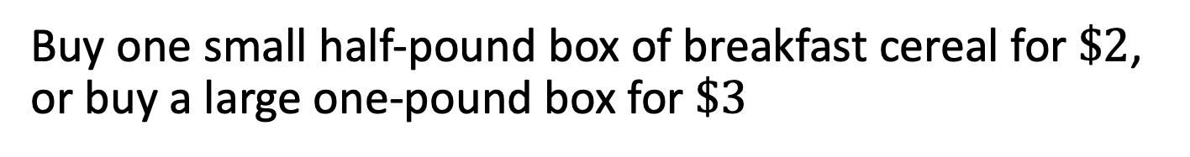
Second-Degree Price Discrimination: Examples
Buy one pair of shoes at full price and get a second pair at half the price
Airline loyalty program: receive more discounts and perks as you accumulate more miles

Slide 22
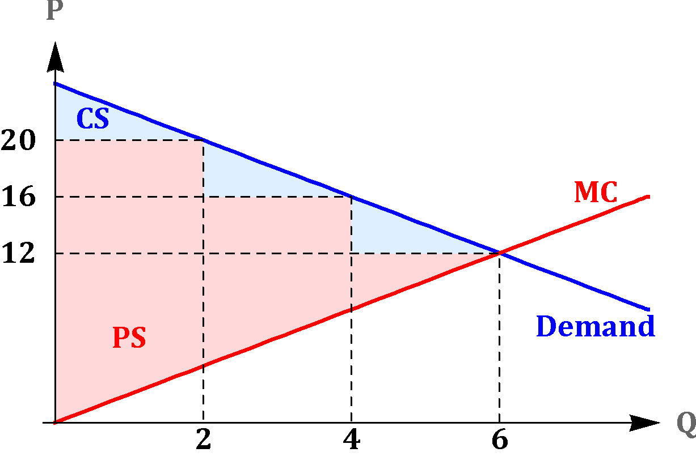
Second-Degree Price Discrimination
Example: Block Pricing
In this example there are 3 blocks:
Pay $20 for units 0 < Q ≤ 2
Pay $16 for units 2 < Q ≤ 4
Pay $12 for units 4 < Q ≤ 6
Block Pricing

Slide 23
Second-Degree Price Discrimination
Example: The 3 block scheme garners more producer surplus than the uniform price scheme at $16
Single-Price
Block Pricing

Slide 24
Second-Degree Price Discrimination
For this type of blocking price to work:
Firm needs to track how many units are being purchased by each different consumer
It must be hard for a consumer to make a profit reselling

Slide 25

Second-Degree Price Discrimination
Recall the breakfast cereal example:
The different boxes allow the firm to track the size of the purchase and implement block prices. It also makes it harder for the consumer to resell part of the cereal.

Slide 26
Microeconomics for Business
Chapter 7 – Price Discrimination
Third-Degree Price Discrimination

Slide 27
Third-Degree Price Discrimination
Third-degree price discrimination refers to the firm's ability to separate consumers into different markets (different groups) and charge a different price in each market.
Example?

Slide 28
Third-Degree Price Discrimination
Example:
Movie theater charges a lower price for students and a higher price for everyone else
The two groups (students and non-students) pay different prices, but the price is the same within each group

Slide 29
Third-Degree Price Discrimination
For this type of pricing strategy to work:
It must be relatively easy for the firm to verify the group identity of a particular consumer and hard for consumers to pretend to be part of the group receiving the lower price
It must be hard for consumers to purchase at the lower price and then make a profit by reselling to another consumer at the higher price (arbitrage)
Example: movie theater requiring student ID

Slide 30
Preventing Arbitrage Case Study
Rohm and Haas make a plastic that can be used in dentistry or for industrial uses.
  Many substitutes in the industrial case
  Few substitutes in dentistry
Which demand curve will be less elastic?
Which price will be higher?

Slide 31
Preventing Arbitrage Case Study
$0.85 per pound for industrial use
$22 per pound for dentistry
How can the company prevent arbitrage?

Slide 32
Preventing Arbitrage Case Study
$0.85 per pound for industrial use
$22 per pound for dentistry
How can the company prevent arbitrage?
Spread a rumor that the industrial plastics are laced with arsenic!

Slide 33
Government actually requires some goods to be poisoned!
Requires fuel ethanol to be poisoned so it can’t be used to make alcohol, this segments the market for ethanol to fuel and alcohol.

Slide 34
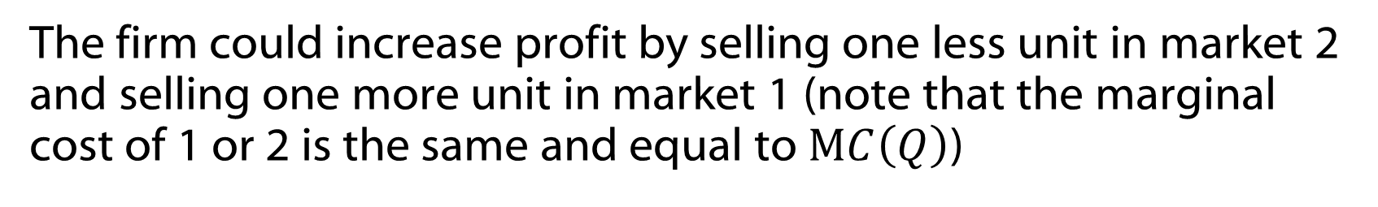
Third-Degree Price Discrimination

Slide 35
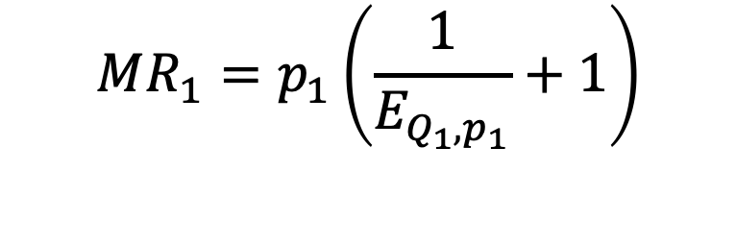
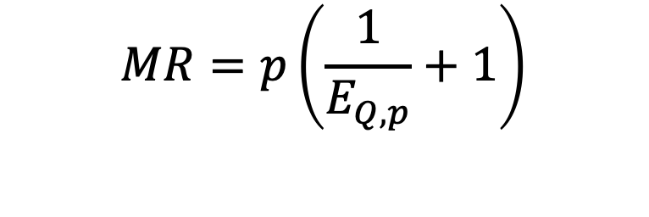
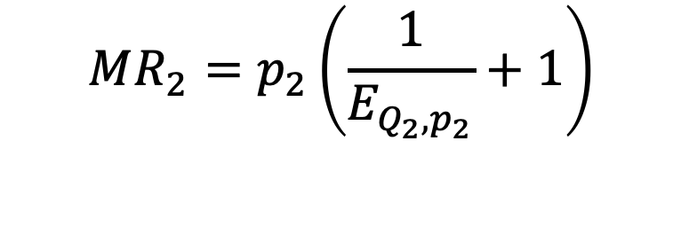
Third-Degree Price Discrimination
The connection between marginal revenue and the price elasticity of demand:

Slide 36

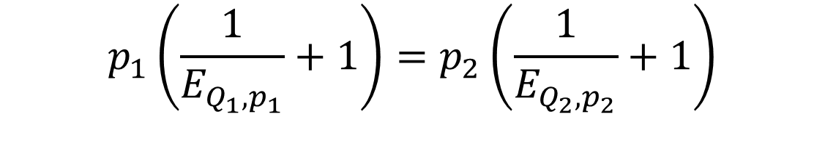
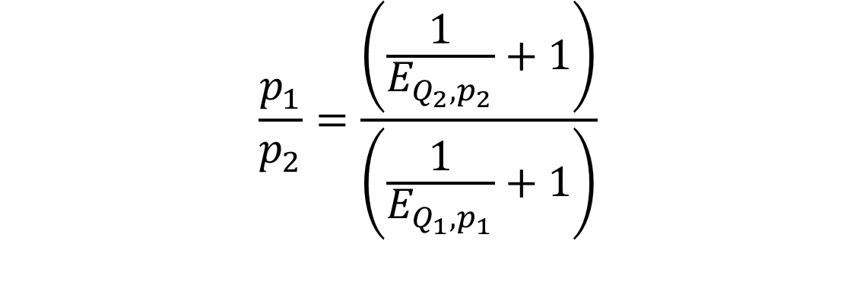
Third-Degree Price Discrimination
Therefore:

Slide 37
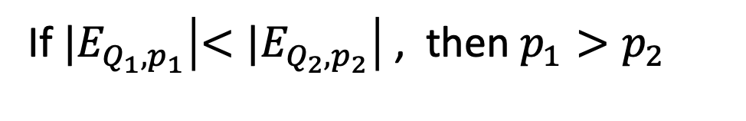
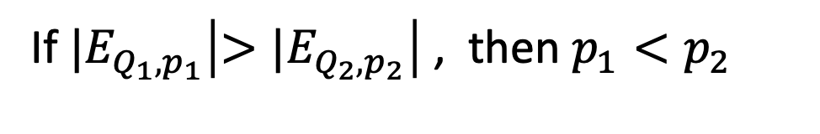
Third-Degree Price Discrimination
Inverse elasticity rule of third-degree discrimination: the firm should price higher in markets with the lowest elasticities, in absolute value.
Higher prices for more inelastic markets is a hallmark of real world third degree schemes

Slide 38
Microeconomics for Business
Chapter 7 – Price Discrimination
Intertemporal Price Discrimination and Peak-Load Pricing

Slide 39
Overview
With the third-degree price discrimination strategy, the firm was able to use some characteristic of the consumers (for example, students versus non-students) to separate them into groups and adjust the prices for each group.
Sometimes the firm uses time as a source of information about consumers and adjusts the price accordingly.

Slide 40
Intertemporal Price Discrimination
The firm engages in intertemporal price discrimination when it releases a new product or service at a higher price, and only later lowers the price.
By doing so, the firm separates consumers with high-demand, who are willing to pay more to have the product right now, and consumers with lower-demand, who are willing to wait for the lower price
Example?

Slide 41
Intertemporal Price Discrimination
Examples:
Fashion companies releasing a new collection
Tech companies releasing updated products
Publishers releasing a new book

Slide 42
Intertemporal Price Discrimination
The firm needs to be careful!
What will be the initial high price and the later sale price?
How long to wait until pricing lower?
If the initial price is too high or if consumers expect the price drop to occur very soon, then too many consumers will wait for the sale price.

Slide 43
Peak-Load Pricing
Peak-Load pricing occurs when the firm charges a higher price during period of peak demand (basically responding to demand shifts) , and a lower price when the demand is lower
Example?

Slide 44
Peak-Load Pricing
Example:
The demand for air-travel is at a peak during Thanksgiving and some other major holiday weeks, while the demand is lower during other non-holiday weeks. Airline ticket prices are much higher during holiday weeks.

Slide 45
Peak-Load Pricing
Example:
Many restaurants have a higher demand during dinner than during lunch, so they decrease the price at lunch by offering special lunch-deals.

Slide 46
Peak-Load Pricing
Example:
In Los Angeles, driving on toll roads during peak traffic is more expensive than on periods of lower demand.

Slide 47
Comparison
Intertemporal price discrimination and peak-load pricing use time as a variable defining the price
Intertemporal price discrimination: related to the life cycle of the product (moving down the demand curve over time)
Peak-load pricing: related to cycles with respect to consumer’s demand (responding to demand shifts that vary by time)

Slide 48
Microeconomics for Business
Chapter 7 – Price Discrimination
Two-Part Tariffs

Slide 49
Two-Part Tariffs
A two-part tariff requires that consumers pay an entry fee for the right to buy the product.
Once this is paid, consumers pay a constant price for each unit of the product she wants to purchase (called usage fee)
Examples?

Slide 50
Two-Part Tariffs
A two-part tariff requires that consumers pay an entry fee for the right to buy the product.
Once this is paid, consumers pay a constant price for each unit of the product she wants to purchase (called usage fee)
Examples: : amusement parks, tennis and golf clubs, some discount stores

Slide 51
Two-Part Tariffs
When the firm has consumers with different preferences, we can write an optimal strategy for what should be the entry fee and the usage fee
However, this optimization problem is rather technical
To provide the basic intuition, we consider the simpler case in which there is a single consumer.

Slide 52
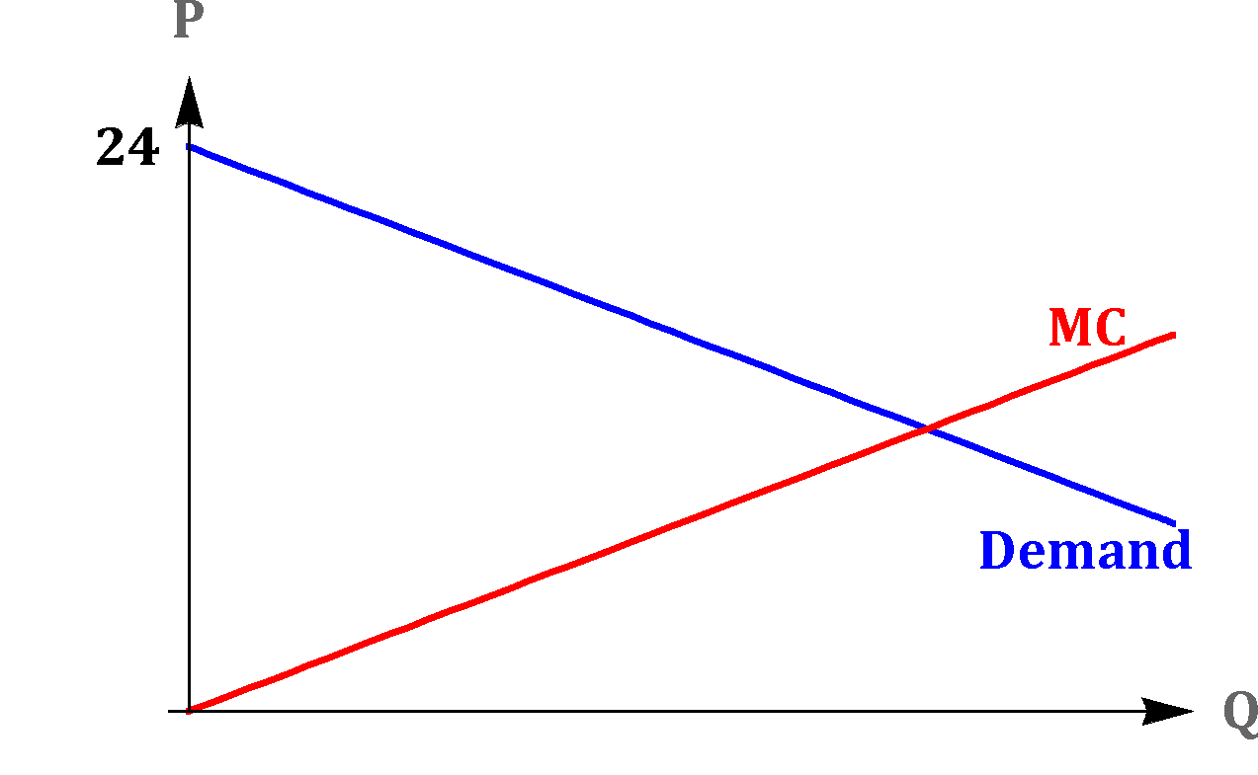
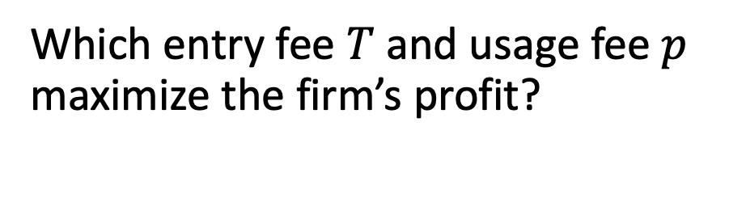
Two-Part Tariffs
Consider a consumer with the demand given by the graph.
The firm is a supermarket

Slide 53
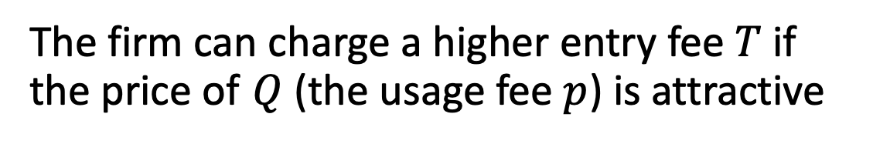
Two-Part Tariffs
Intuition:

Slide 54
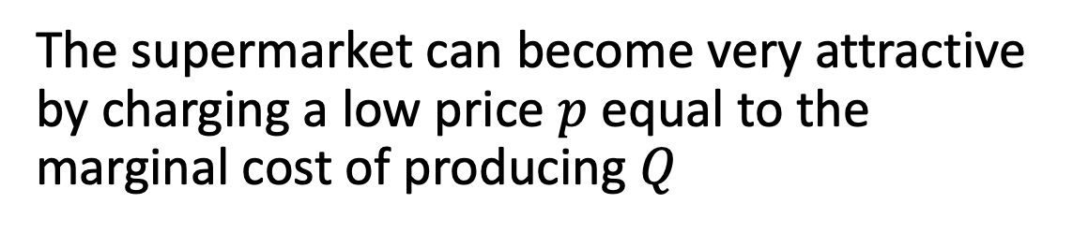
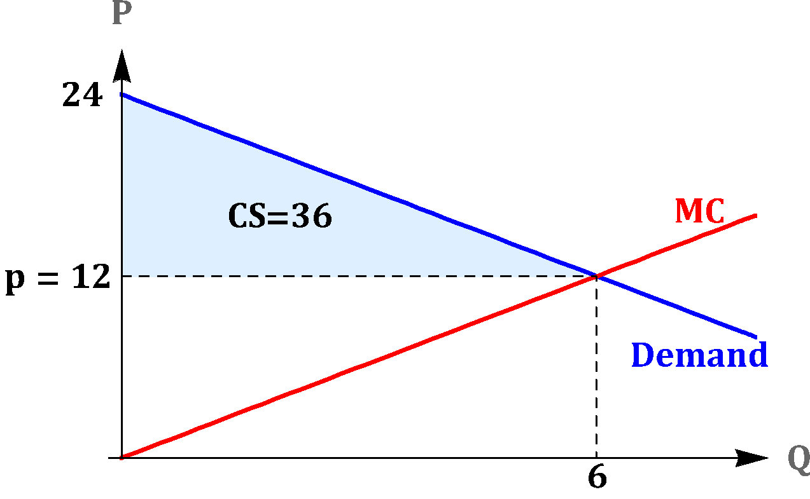
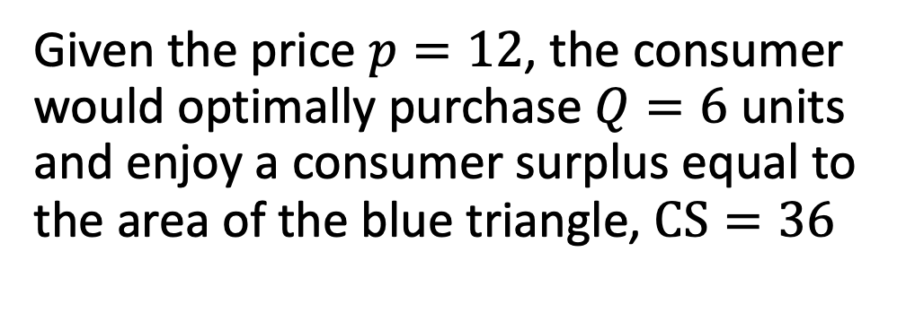
Two-Part Tariffs

Slide 55

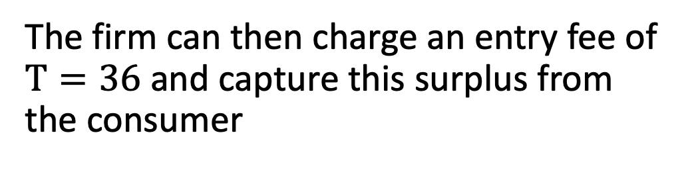
Two-Part Tariffs

Slide 56
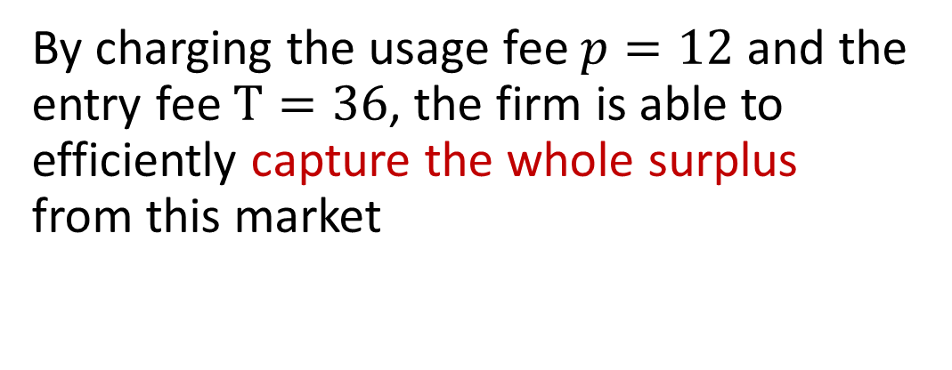
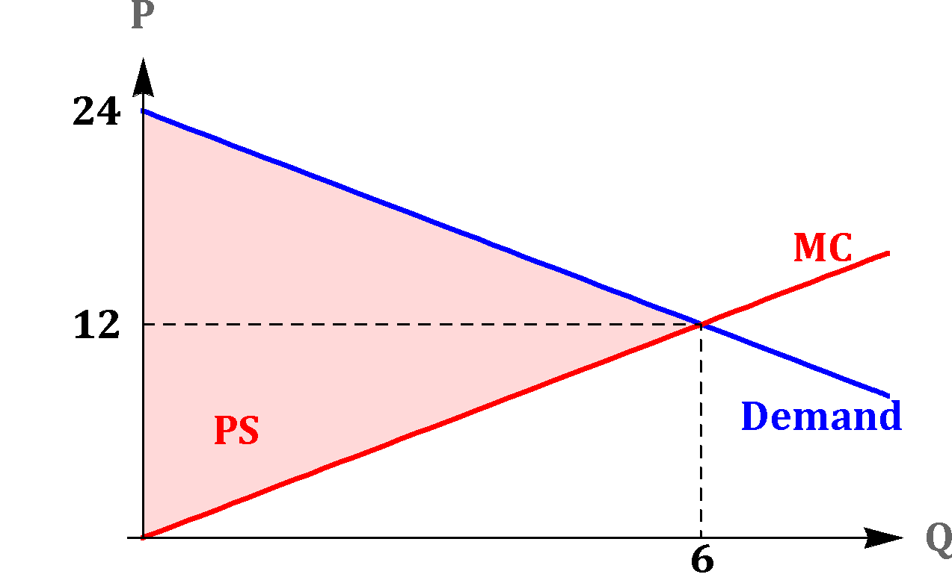
Two-Part Tariffs

Slide 57
Microeconomics for Business
Chapter 7 – Price Discrimination
Bundling and Tying

Slide 58
Bundling
The firm bundles different products together and charges a single price for the bundle
Example?

Slide 59
Bundling
Examples: restaurants with complete dinners and a la carte, Cable TV, Adobe products, Microsoft products

Slide 60
Bundling
Bundling results in higher profits than separate pricing when demands are negatively correlated across consumers.
In the following example we will demonstrate this point.

Slide 61
Bundling
Bundling results in higher profits than separate pricing when demands are negatively correlated across consumers.
In the following example we will demonstrate this point.

Slide 62
Bundling
 | action fan | sci-fi fan
action movie | $2.50 | $1.00
sci-fi movie | $1.00 | $2.75
Example: Streaming Service
Suppose that the firm’s marginal cost of streaming is zero

Slide 63
Bundling
 | action fan | sci-fi fan
action movie
sci-fi movie
 | action fan | sci-fi fan
action movie | $2.50 | $1.00
sci-fi movie | $1.00 | $2.75
Example
Suppose the firm cannot bundle movies.
How much should be the price of the action movie?
How much should be the price of the sci-fi movie?

Slide 64
Bundling
 | action fan | sci-fi fan
action movie
sci-fi movie
 | action fan | sci-fi fan
action movie | $2.50 | $1.00
sci-fi movie | $1.00 | $2.75
Example
Suppose the firm cannot bundle movies.
How much should be the price of the action movie? Answer: $2.50
How much should be the price of the sci-fi movie?

Slide 65
Bundling
 | action fan | sci-fi fan
action movie
sci-fi movie
 | action fan | sci-fi fan
action movie | $2.50 | $1.00
sci-fi movie | $1.00 | $2.75
Example
Suppose the firm cannot bundle movies.
How much should be the price of the action movie? Answer: $2.50
How much should be the price of the sci-fi movie? Answer $2.75

Slide 66
Bundling
 | action fan | sci-fi fan
action movie
sci-fi movie
 | action fan | sci-fi fan
action movie | $2.50 | $1.00
sci-fi movie | $1.00 | $2.75
Example
Suppose the firm cannot bundle movies.

Slide 67


Bundling
 | action fan | sci-fi fan
action movie
sci-fi movie
 | action fan | sci-fi fan
action movie | $2.50 | $1.00
sci-fi movie | $1.00 | $2.75
Example

Slide 68


Bundling
 | action fan | sci-fi fan
action movie
sci-fi movie
 | action fan | sci-fi fan
action movie | $2.50 | $1.00
sci-fi movie | $1.00 | $2.75
Example

Slide 69
Tying
A firm using the tying strategy sells one product with a secondary complementary product.
A consumer who buys the first or primary product is urged, is technologically compelled or is required to buy, as a term of purchase, the secondary product from the same producer.
Example?

Slide 70
Tying
Examples: coffee machines and coffee pods
printers and toner cartridges
water purifiers and filters

Slide 71
Tying
The key value to tying is that it makes the firm a monopolist in the sale of the secondary product

Slide 72
Tying
Sometimes the firm makes the tying relationship mandatory by making the primary product incompatible with other brands of the secondary product

Slide 73
Tying
In other cases, the tying relationship is voluntary with the firm selling the primary product strongly urging the consumer to purchase the secondary complementary product from them

Slide 74
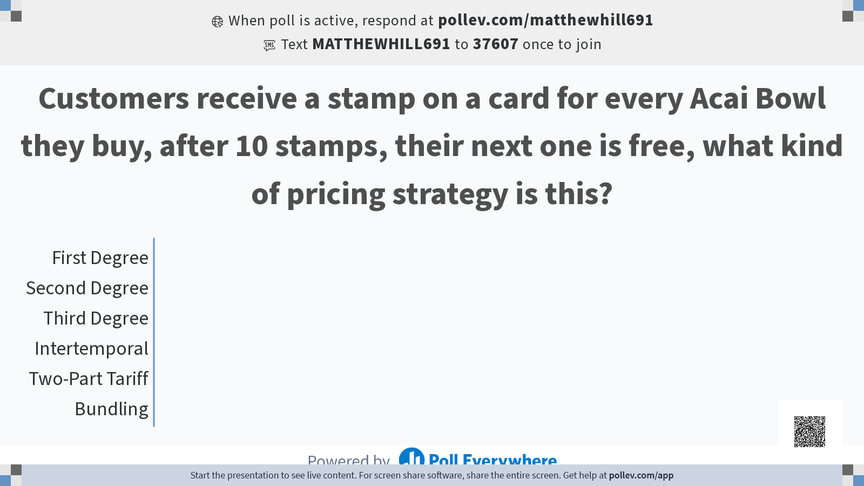

Slide 75
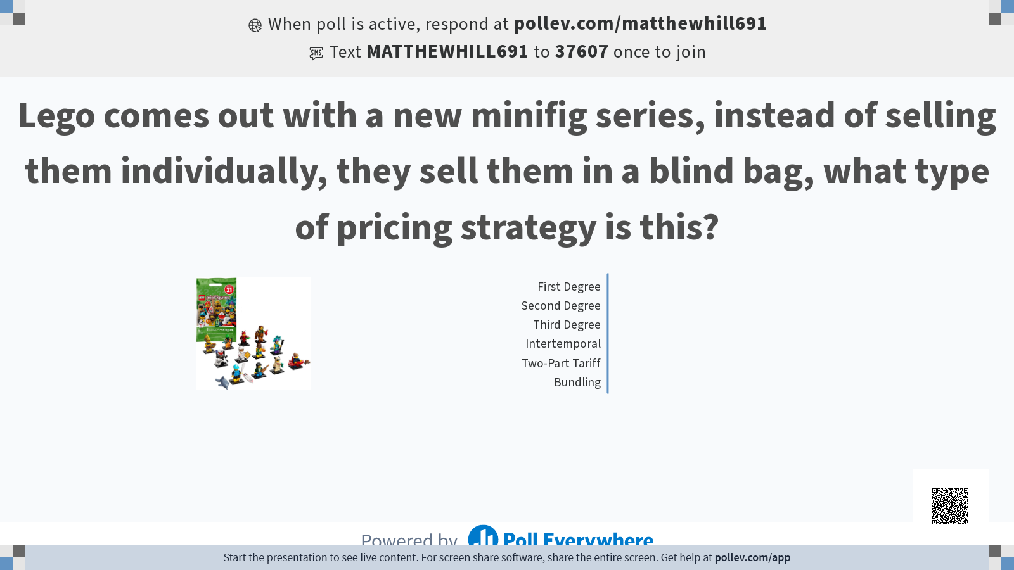

Slide 76
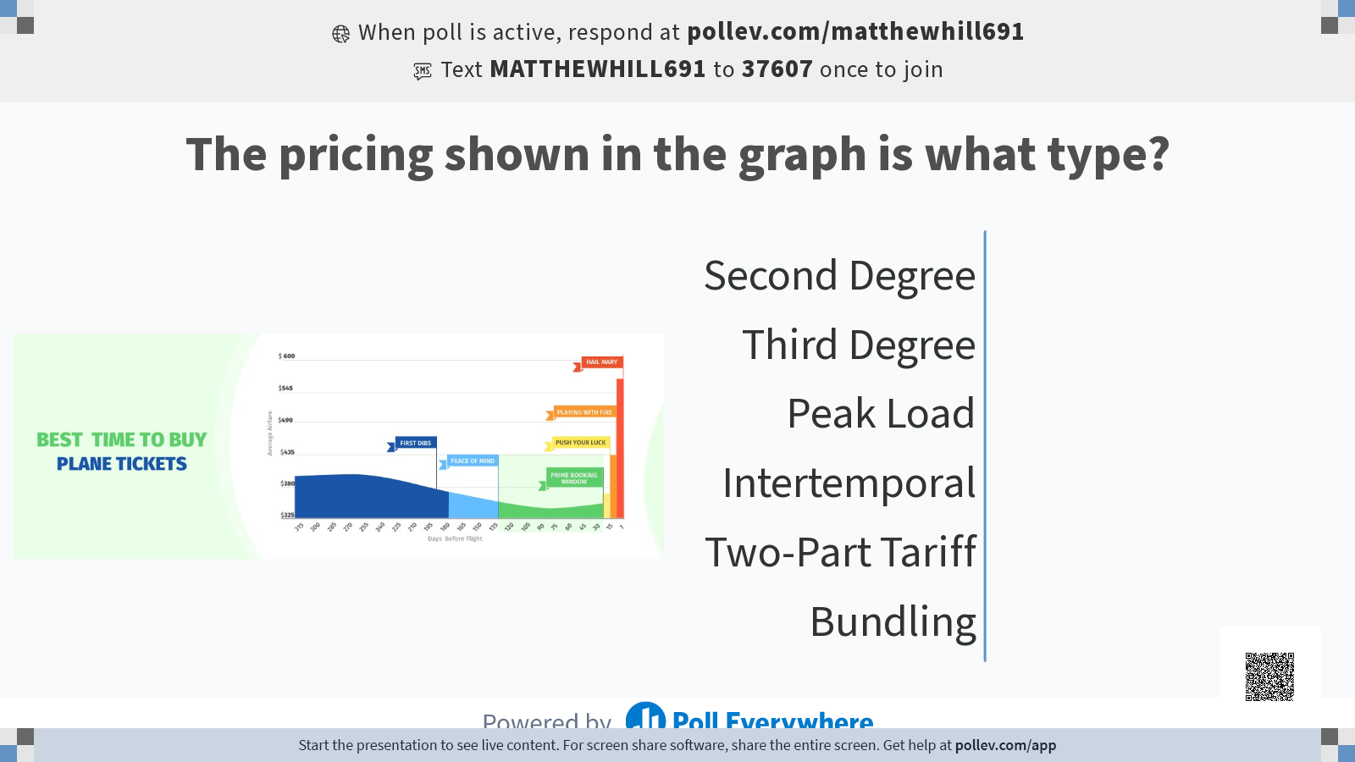

Slide 77
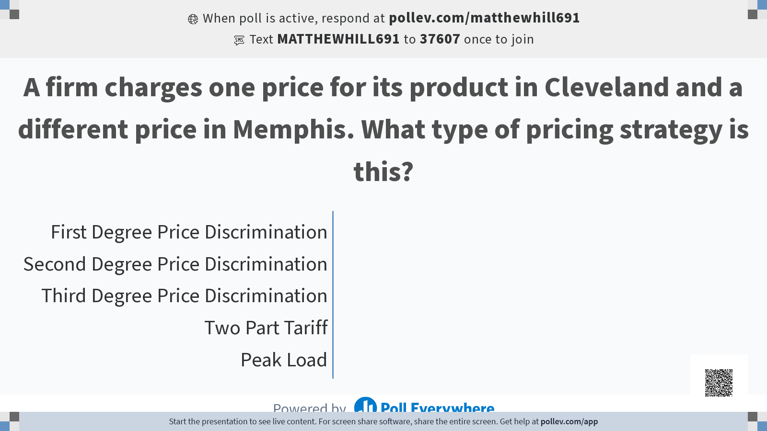

Slide 78


